Slide 1


DATA
ANALYSIS
In order to identify trends, comprehend consumer behaviour, and offer useful suggestions for tactical decision-making

Slide 2



OUR
PROJECT
To improve visitor experiences and streamline corporate processes by utilizing data-driven insights.
ABOUT
Dataleum Hotel Groups (DHG) is renowned hospitality company

Slide 3

METHODOLOGIES
USED
1. Data Collection & Preparation
Source: The data used in the analysis comes from internal booking systems, capturing details such as lead time, cancellations, customer types, booking channels, and revenue metrics.
Cleaning: Data was cleaned to handle missing values, duplicate entries, and inconsistencies, ensuring accuracy before analysis. Null values for revenue or missing customer types were handled by applying filtering in Power Query.

Slide 4

METHODOLOGIES
2. Visualization Techniques
Correlation Analysis: Name cards and filters were used to visualize the correlation between lead time and cancellations, and line charts were used to illustrate trends in revenue loss across different booking channels and customer types.
Bar and Column Charts: These charts were used to represent the total revenue and cancellation rates by customer segment, making it easier to compare different groups side-by-side..
Tree Maps and Pie Charts: Displayed customer type distribution and helped in identifying key segments contributing to revenue generation.

Slide 5
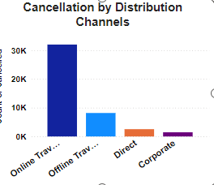
ACTIONABLE
INSIGHTS
1. Cancellations
Insight: Customers with shorter lead times tend to have a higher rate of cancellations.
Action: Implement strategies like early booking discounts to encourage longer lead times, thus reducing cancellation rates.
Action: Target high-cancellation segments (e.g., tourists) with personalized incentives to reduce cancellation risk.
Insight: e Online Travel Agent have a higher cancellation rate compared to other bookings channels.
Action: Enhance Direct & corporate booking channels by offering additional services or better flexibility for changes and to reduce reliance on third-party channels with higher cancellation rates.

Slide 6
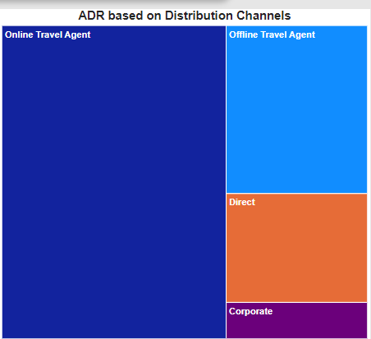
ACTIONABLE
INSIGHTS
2. Revenue
Insight: Revenue loss due to cancellations is higher in certain customer segments, particularly Family clients.
Action: Introduce flexible pricing or offer rebooking incentives to mitigate lost revenue.
Insight: Distribution channels such as Online Travel Agent bookings show a higher Average Daily Rate (ADR) compared to other channels.
Action: Focus marketing campaigns on increasing online travel agent bookings, which offer a higher ADR and contribute more to overall revenue. This could include loyalty programs or discounts for repeat customers.

Slide 7
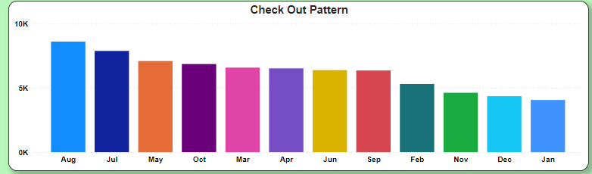
ACTIONABLE
INSIGHTS
3. Resource Allocation and Staffing
Insight: There are clear patterns in check-out dates, with peak periods aligning with holiday seasons and weekends.
Action: Adjust staffing levels to match demand during peak check-out periods, ensuring optimal service without overspending on resources during low-demand times.

Slide 8
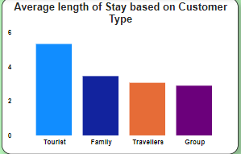
ACTIONABLE
INSIGHTS
4. Resource Allocation and Staffing
Insight: Longer stays (number of nights) typically coincide with specific customer types
Action: Use these patterns to optimize room turnover schedules and resource allocation for housekeeping and other services during these periods.

Slide 9
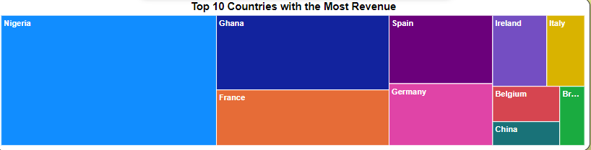
ACTIONABLE
INSIGHTS
5. Distribution of Bookings by Country of Origin
Insight: Countries with higher number of guests could be targeted by using its existing marketing strategies to improve low guest countries marketing campaigns or promotions.
Action: Target countries with fewer bookings for growth opportunities through online ads, partnerships, or localized marketing strategies.

Slide 10

THANK YOU

